Slide 1

CHEMICAL REACTIONS AND EQUATIONS
Module_01

Slide 2

CHEMICAL REACTIONS AND EQUATIONS

Slide 3
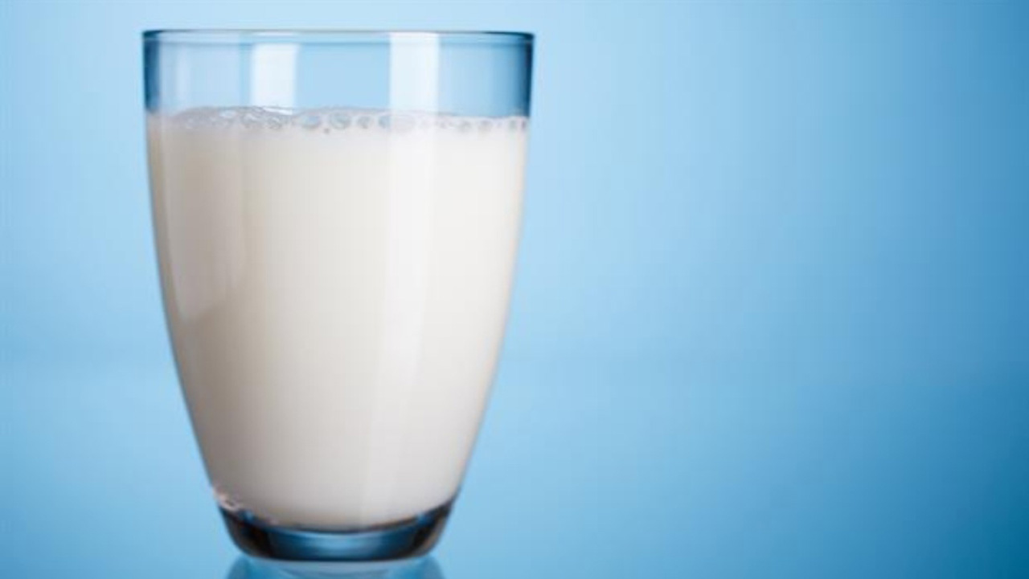
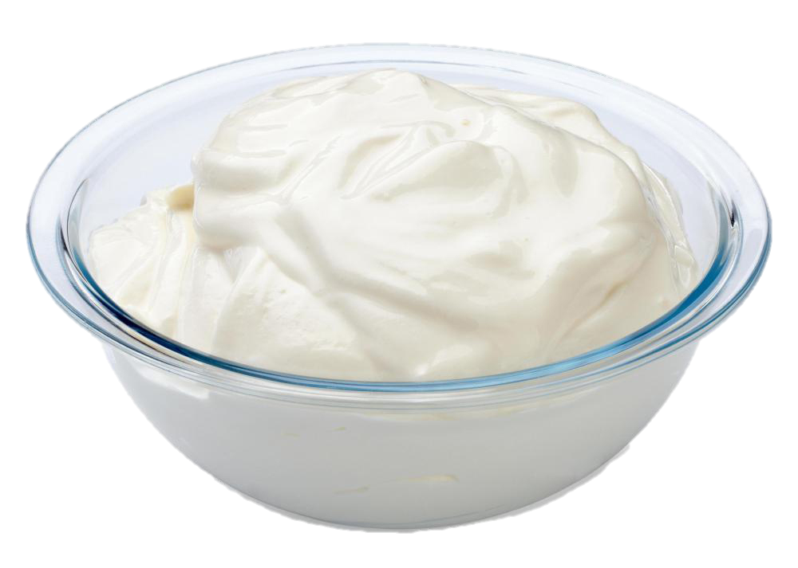
INTRODUCTION
Milk is left at room temperature during summers

Slide 4
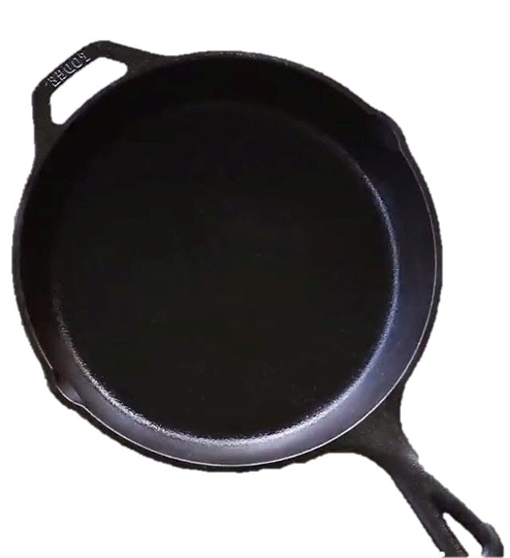
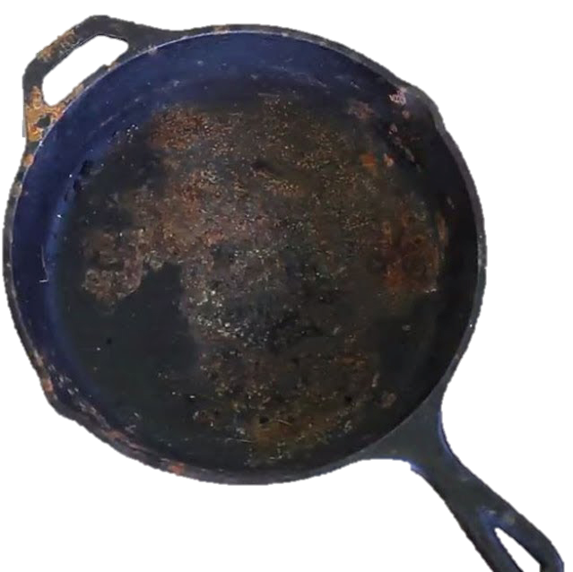
An iron tawa/pan/nail is left exposed to humid atmosphere.

Slide 5
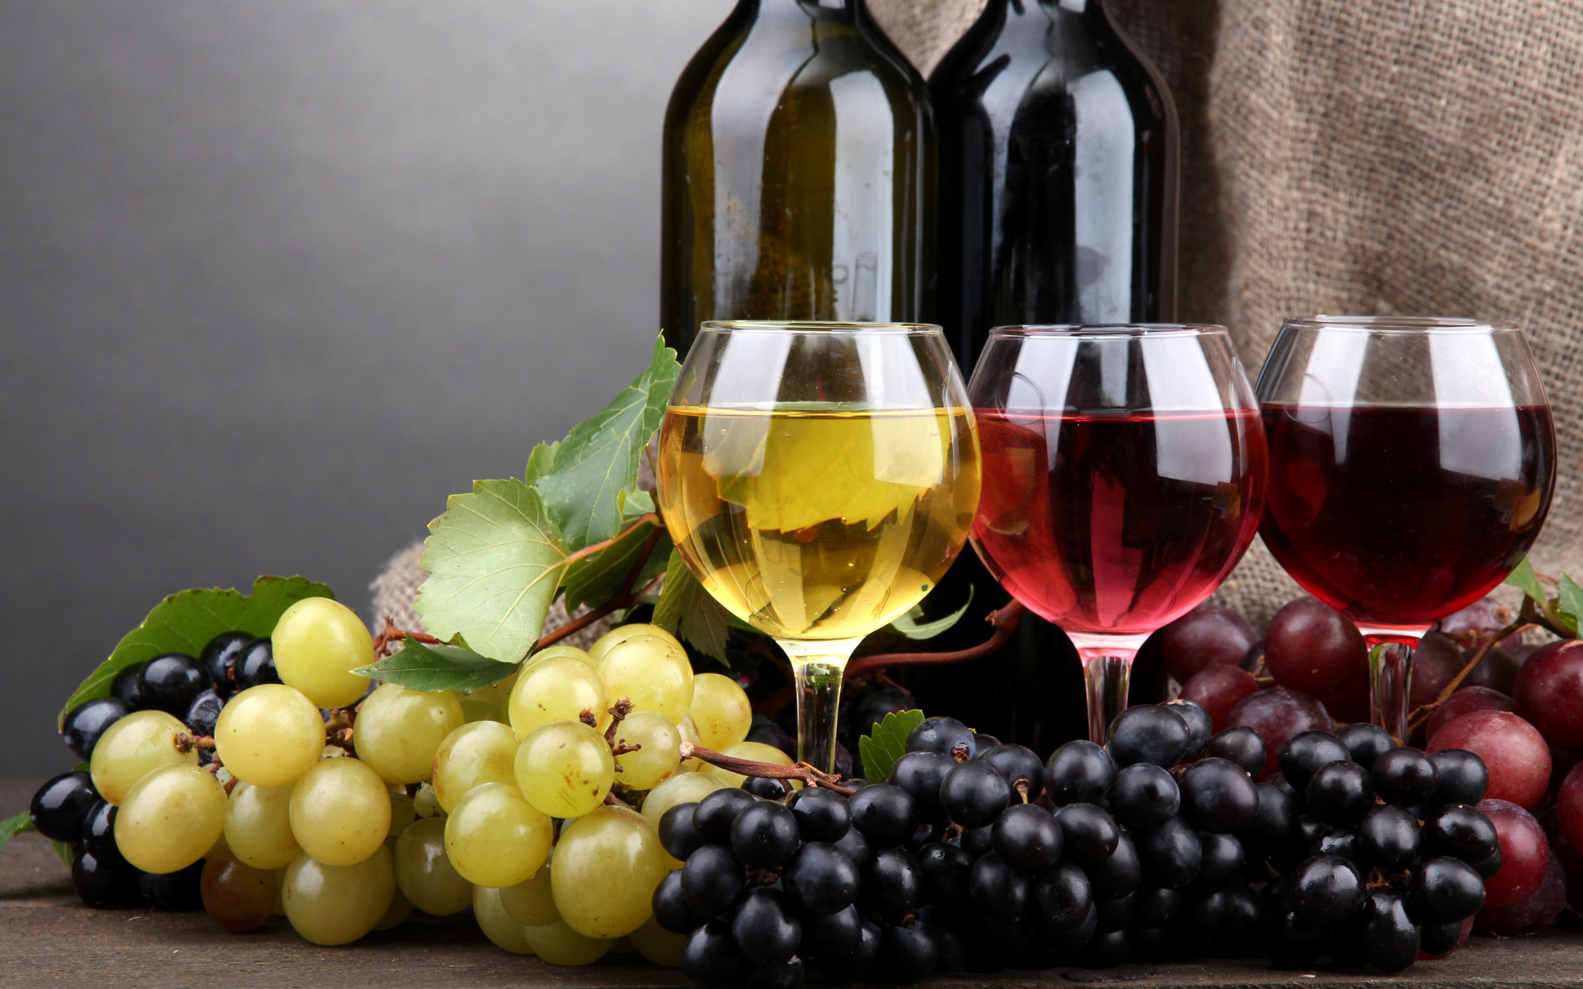
Grapes get fermented

Slide 6
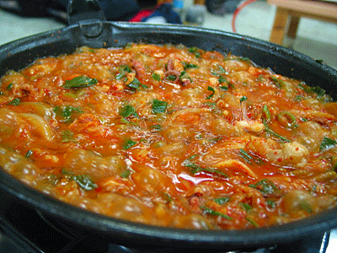
Food is cooked

Slide 7
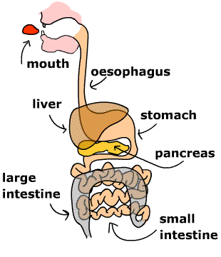
Food gets digested in our body.

Slide 8
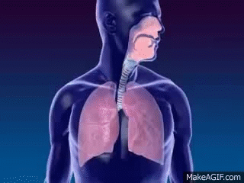
We respire

Slide 9
In all the above situations, the nature and the identity of the initial substance have somewhat changed.
Whenever a chemical change occurs, we can say that a chemical reaction has taken place.

Slide 10

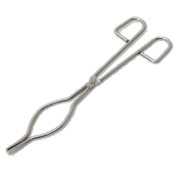
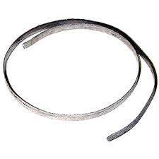
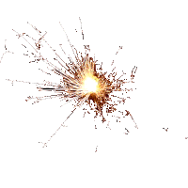




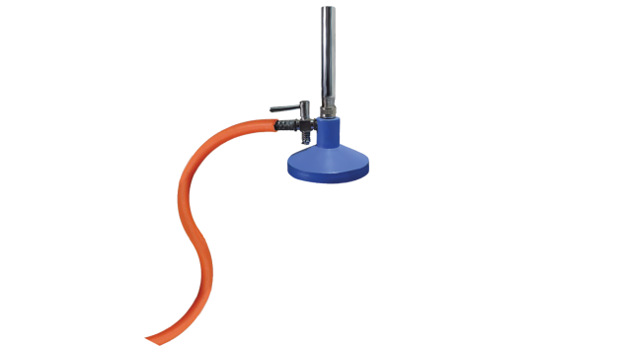
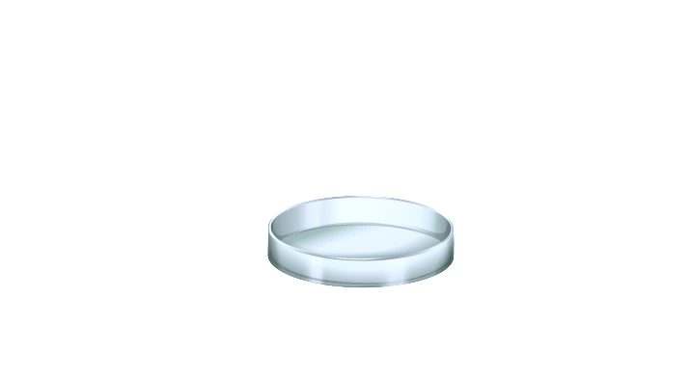

Conclusion
Activity
What do you observe?
As we have observed that magnesium ribbon burns with a dazzling white flame.
CAUTION: This Activity needs the teacher’s assistance. It would be better if students wear eye protection.
Hold it with a pair of tongs.
Clean a magnesium ribbon about 2 cm long by rubbing it with sandpaper.
Burn it using a spirit lamp or burner and collect the ash so formed in a watch-glass as shown in
It changes into a white powder.
This powder is magnesium oxide.
It is formed due to the reaction between magnesium and oxygen.
Tongs
Magnesium ribbon
Bunsen burner
Magnesium oxide

Slide 11


Activity
Yellow coloured precipitate of lead iodide is formed.
Test tube
Lead nitrate solution
Lead iodide
Potassium iodide
Test tube stand

Slide 12


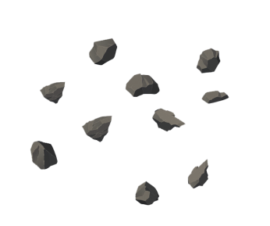
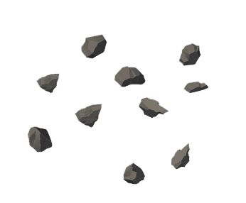
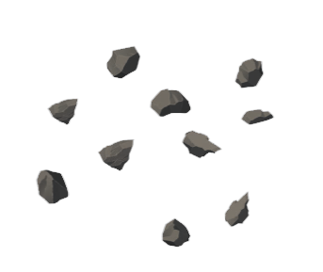








Conclusion
Activity
Formation of bubbles(Evolution of gas)
Heat is given out (change of temperature)
Change of state
Cork
Glass tube
Conical flask
H₂ gas
Dilute sulphuric acid
Zinc granules
Test tube stand
dilute H₂SO₄

Slide 13

From the above three activities, we can say that any of the following observations helps us to determine whether a chemical reaction has taken place –
1
Change in state
2
Change in colour
3
Evolution of a gas
4
Change in temperature
5
Formation of precipitate

Slide 14
CHEMICAL REACTIONS AND EQUATIONS
Module_02

Slide 15
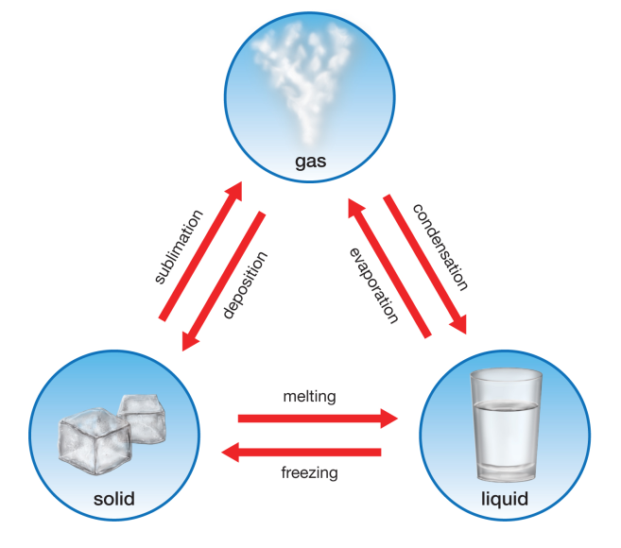
CHEMICAL REACTIONS AND EQUATIONS
Change in state

Slide 16
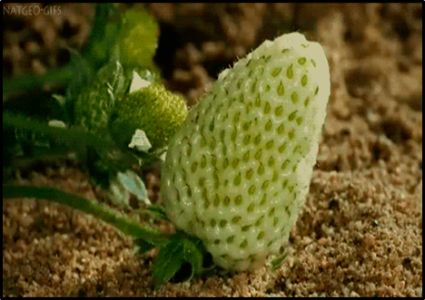
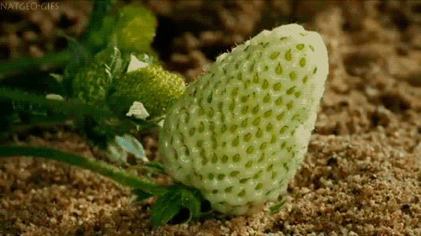
Change in colour

Slide 17
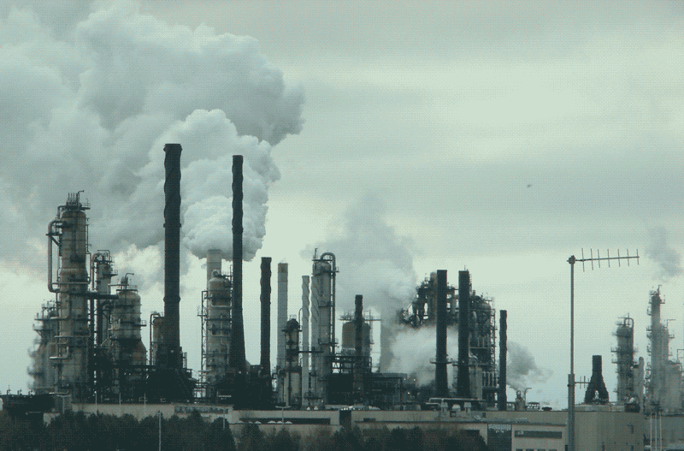
Evolution of a gas

Slide 18
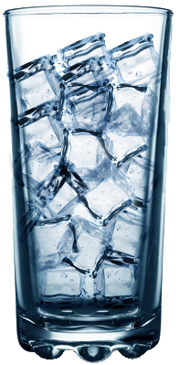
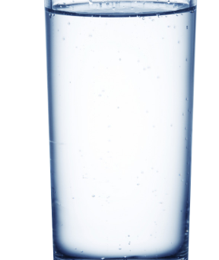
Change in temperature

Slide 19
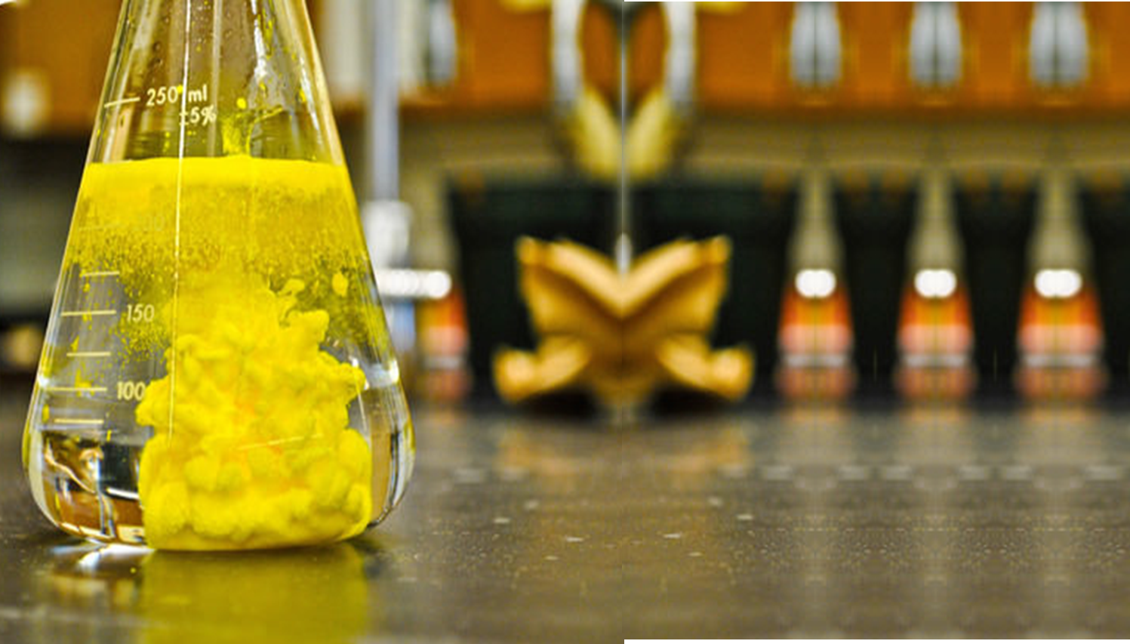
Formation of a precipitate

Slide 20

VALENCY CHART
OH–
–
Hydroxide
Cd²⁺
–
Cadmium
Cl–
–
Chloride
Ca²⁺
–
Calcium
Br–
–
Bromide
Mg²⁺
–
Magnesium
I–
–
Iodide
Hg²⁺
–
Mercury
NO₃–
–
Nitrate
Zn²⁺
–
Zinc
sab ki
valency hai 1
sab ki
valency hai 2
HCO₃–
–
Bicarbonate
Ba²⁺
–
Barium
AlO₂–
–
Aluminate
O^{2–}
–
Oxide
Ag⁺
–
Silver
S^{2–}
–
Sulphide
CrO₄^{2–}
–
Chromate
Na⁺
–
Sodium
CO₃^{2–}
–
Carbonate
H⁺
–
Hydrogen
SO₄^{2–}
–
Sulphate
K⁺
–
Potassium
ZnO₂^{2–}
–
Zincate
Copper (Cu) and Iron (Fe) both of them have variable valency
Copper - 1, 2
Iron - 2, 3 but
but Aluminium (Al) ki valency hai fixed 3
NH₄⁺ - Ammonium 1, Pb²⁺ - Lead - 2

Slide 21

CHEMICAL EQUATIONS
A simple representation of a
chemical reaction in words is called
a word equation.
Arrow indicates
to yield
shows the direction
Magnesium
+
Oxygen
Magnesium oxide
Left Hand Side (L.H.S)
Right Hand Side (R.H.S)
Reactants
Products

Slide 22
A chemical equation is a short-hand
form for a chemical change.
Arrow indicates
to yield
shows the direction
Mg
+
O₂
MgO
Left Hand Side (L.H.S)
Right Hand Side (R.H.S)
Reactants
Products
If the number of atoms of each element on the both sides is same then it is balanced
equation else equation is unbalanced or skeletal chemical equation.
So above reaction is example of skeletal chemical equation.

Slide 23
STEPS INVOLVED IN WRITING CHEMICAL EQUATION
LHS
RHS
1) Reactants: _______ and Products: _______
ARROW
2) Reactants and Products: separated by an __________
3) 2 or more reactants /products: separated by
______________
PLUS(+)SIGN
ON ARROW
4) Conditions: mentioned _____________
PHYSICAL STATES
5) ____________________ of reactants and product:
to make reaction more informative
∆
Mg_{(s)}
+
O_{2(g)}
MgO_{(s)}
_{(s)}
_{(g)}
_{(s)}
Reactants
Products

Slide 24
CHEMICAL REACTIONS AND EQUATIONS
Module_03

Slide 25

BALANCING CHEMICAL EQUATIONS

Slide 26

LAW OF CONSERVATION OF MASS : Mass can neither be created nor destroyed in a chemical reaction. That is, the total mass of the elements present in the products of a chemical reaction has to be equal to the total mass of the elements present in the reactants.
A
+
B
AB
Total mass of elements in the reactants
Total mass of elements in the products
=

Slide 27

As the number of atoms of element is the same on the both sides of the arrow. Hence it is a balanced chemical equation.
As per law of conservation of mass :
Zinc
+ Sulphuric acid
Zinc sulphate
+ Hydrogen
Zn
+
H₂
+
Zn
H₂
ZnSO₄
S
H₂
O₄
O₄
Zn
H₂SO₄
S
Reactants (LHS)
Products (RHS)
Element
Number of atoms
Number of atoms
Zn
1
1
H
2
2
S
1
1
O
4
4

Slide 28
Step I
Draw boxes around each formula
Step II
List the number of atoms of different elements
Fe
+ H₂O
Fe₃O₄
+ H₂
Reactants (LHS)
Products (RHS)
Element
Number of atoms
Number of atoms
Fe
1
3
H
2
2
O
1
4

Slide 29
Step III
We can not alter the formulae of the compounds or elements to equalise the number of atoms.
For example to balance oxygen atoms we can put coefficient 4 as 4 H₂O and not H₂O₄ or (H₂O)₄
Start balancing the compound that contains maximum no of atoms
To balance the oxygen
atoms.
Fe₃O₄
Fe
+ H₂O
Fe₃O₄
+ H₂
4
Atoms of oxygen
In reactants
In products
(i) initial
1in H₂O
4 in (Fe₃O₄)
(ii) To balance
1 x 4
4

Slide 30
Step IV
Let us balance hydrogen atoms in the partly balanced equation.
Fe
+ H₂O
Fe₃O₄
+ H₂
4
4
Atoms of hydrogen
In reactants
In products
(i) initial
8 (in 4 H₂O)
2 ( in H₂)
(ii) To balance
8
2x4

Slide 31
Step V
Let us balance Iron atoms in the partly balanced equation.
Fe
+ H₂O
Fe₃O₄
+ H₂
3
4
4
Atoms of Iron
In reactants
In products
(i) initial
1 (in Fe)
3 ( in Fe₃O₄)
(ii) To balance
1 x 3
3

Slide 32
Step VI
Check the correctness of the balanced equation.
This method of balancing chemical equations is called hit -and-trial method.
Fe
+ H₂O
Fe₃O₄
+ H₂
3
4
4

Slide 33
Step VII
The physical states of the reactants and products are mentioned along with their chemical formulae.
The gaseous, liquid, aqueous and solid states of reactants and products are represented by the notations (g), (l), (aq) and (s).
So the balance equation becomes
3 Fe _{(s)}
+ 4 H₂O _{(g)}
Fe₃O_{4 (s)}
+ 4 H_{2 (g)}

Slide 34
Step VIII
Sometimes the reaction conditions, such as temperature, pressure, catalyst, etc., for the reaction are indicated above and/or below the arrow in the equation.
For example
340 atm
CO _{(g)}
+ 2 H₂ _{(g)}
CH₃OH _{(I)}
Sunlight
6 CO₂ _{(aq)}
+ 12 H₂O _{(I)}
C₆H₁₂O_{6 (aq)}
+ 6 O_{2 (aq)}
+ 6 H₂O _{(I)}
Chlorophyll

Slide 35
CHEMICAL REACTIONS AND EQUATIONS
Module_04

Slide 36

TYPES OF CHEMICAL REACTIONS
We have learnt that during a chemical reaction atoms of one element do not
change into those of another element.
Nor do atoms disappear from the mixture or appear from elsewhere.
Actually, chemical reactions involve the breaking and making of bonds
between atoms to produce new substances.

Slide 37
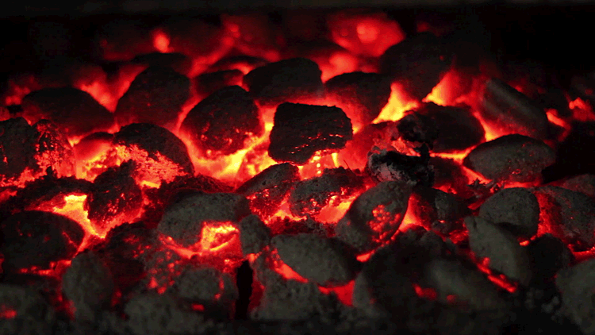
BURNING OF COAL
CO₂
O
C
O
C_{(s)}
+
O_{2(g)}
CO_{2(g)}
Carbon
Oxygen
Carbon dioxide

Slide 38
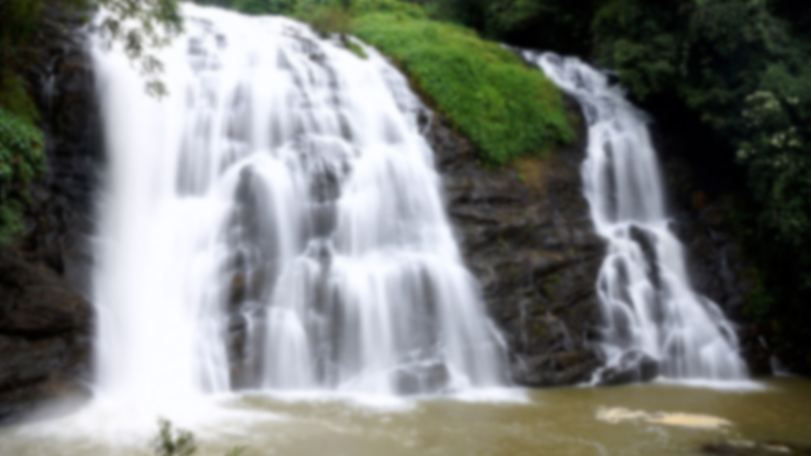
FORMATION OF WATER
H
H₂O
O
H
One atom of oxygen
combines with two
atoms of hydrogen to
form water molecule.
2 H_{2(g)}
+
O_{2(g)}
2H₂O_{(l)}
Hydrogen
Oxygen
Water

Slide 39

COMBINATION REACTION
A
+
B
AB
A chemical reaction in which two or more reactants combine to form a Single product, is called COMBINATION REACTION.

Slide 40



CaO_{(s)}
+
H₂O_{(l)}
Ca(OH)_{2(aq)}
Quick lime
Water
Slaked lime
25°
30º
Water
Slaked lime
Calcium oxide

Slide 41


A solution of slaked lime produced is used for white washing walls.
Calcium hydroxide reacts slowly with the carbon dioxide in air to form a thin layer of calcium carbonate on the walls.
Calcium carbonate is formed after two to three days of white washing and gives a shiny finish to the walls.
It is interesting to note that the chemical formula for marble is also CaCO₃.
Ca (OH)_{2(aq)}
+
CO_{2(g)}
CaCO_{3(s)}
+
H₂O_{(I)}
Calcium hydroxide
Carbon dioxide
Calcium carbonate
Water

Slide 42
CHEMICAL REACTIONS AND EQUATIONS
Module_05

Slide 43

EXOTHERMIC REACTION
I.
Burning of natural gas :
Reactions in which heat is
released along with the
formation of products are called
exothermic chemical reactions.
CH_{4(s)}
+
2
O_{2(g)}
CO_{2(g)}
+
2
H₂O _{(g)}
+
Heat
Methane
Oxygen
Carbon dioxide
Water

Slide 44
i.
Respiration reaction :
C₆H₁₂O_{6(aq)}
+
6
O_{2(aq)}
6
CO_{2(aq)}
+
6
H₂O _{(l)}
+
Energy
Sugar
Oxygen
Carbon dioxide
Water

Slide 45
The decomposition of vegetable matter into compost is also an example of an
exothermic reaction.

Slide 46
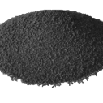
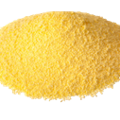
Endothermic reaction
Fe_{(s)}
+
S_{(s)}
+
Heat
FeS_{(s)}
Iron
Sulphur
Iron
sulphide
Reactions in which heat is absorbed are called endothermic chemical reactions.
Iron sulphide
Iron
Sulphur
Wire gauze
Tripod stand
Burner

Slide 47
CHEMICAL REACTIONS AND EQUATIONS
Module_06

Slide 48
DECOMPOSITION REACTION
AB
A
+
B
A chemical reaction in which a compound is split into two or more simple substances is called as DECOMPOSITION REACTION.

Slide 49


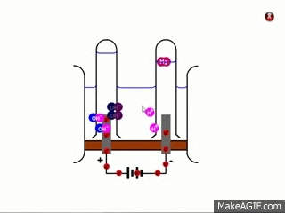

DECOMPOSITION REACTION
Can take place under 3 conditions
HEAT
LIGHT ENERGY
ELECTRICITY
Electrolysis of water

Slide 50











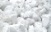
CaCO_{3(s)}
Heat
CaO_{(s)}
HEATING OF CALCIUM CARBONATE
+
CO_{2(g)}
Calcium carbonate
Calcium
oxide
Carbon
dioxide
(Limestone)
(Quick lime)
Used in Manufacturing of cement
Carbon dioxide gas
Turns milky
Calcium oxide
Calcium carbonate
Calcium hydroxide
solution (lime water)
Bunsen burner

Slide 51

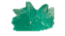
Heat
Heat
Fe₂O_{3(S)}
+
SO_{2(g)}
+
SO_{3(g)}
FeSO₄.7H₂O
FeSO₄
7H₂O
2
FeSO_{4(s)}
+
HEATING OF FERROUS SULPHATE
Ferrous sulphate
Ferric
oxide
Sulphur
dioxide
Water
Sulphur
trioxide
Green
Colourless
Do not point the mouth of boiling
tube at your neighbours or
yourself.
Smell ?
Ferrous oxide
Ferrous sulphate crystals
Bunsen burner

Slide 52
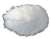
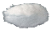
Heat
HEATING OF LEAD NITRATE
Brown fumes
of nitrogen oxide
4
2
Pb(NO₃)_{2(s)}
2
PbO_{(s)}
+
NO_{2(s)}
+
O_{2(g)}
Lead nitrate
Lead oxide
Nitrogen dioxide
Oxygen
A decomposition reaction carried out by heating is called as, Thermal decomposition reaction.
Lead nitrate
Lead oxide
Bunsen burner

Slide 53
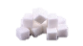
C₁₂H₂₂O_{11(s)}
∆
12
C_{(s)}
11
+
H₂O_{(g)}
THERMAL DECOMPOSITION REACTION
Sugar
Carbon
Water
indicates evolution of gas
Test tube
Sugar
Bunsen burner

Slide 54
So we conclude
A decomposition reaction carried out by heating is called as, Thermal decomposition reaction.
HEATING OF CALCIUM CARBONATE
HEATING OF FERROUS SULPHATE
HEATING OF LEAD NITRATE
HEATING OF SUGAR

Slide 55
CHEMICAL REACTIONS AND EQUATIONS
Module_07

Slide 56
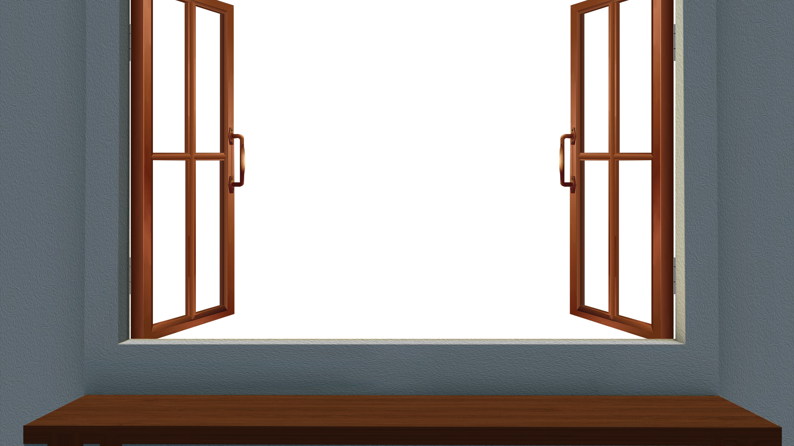
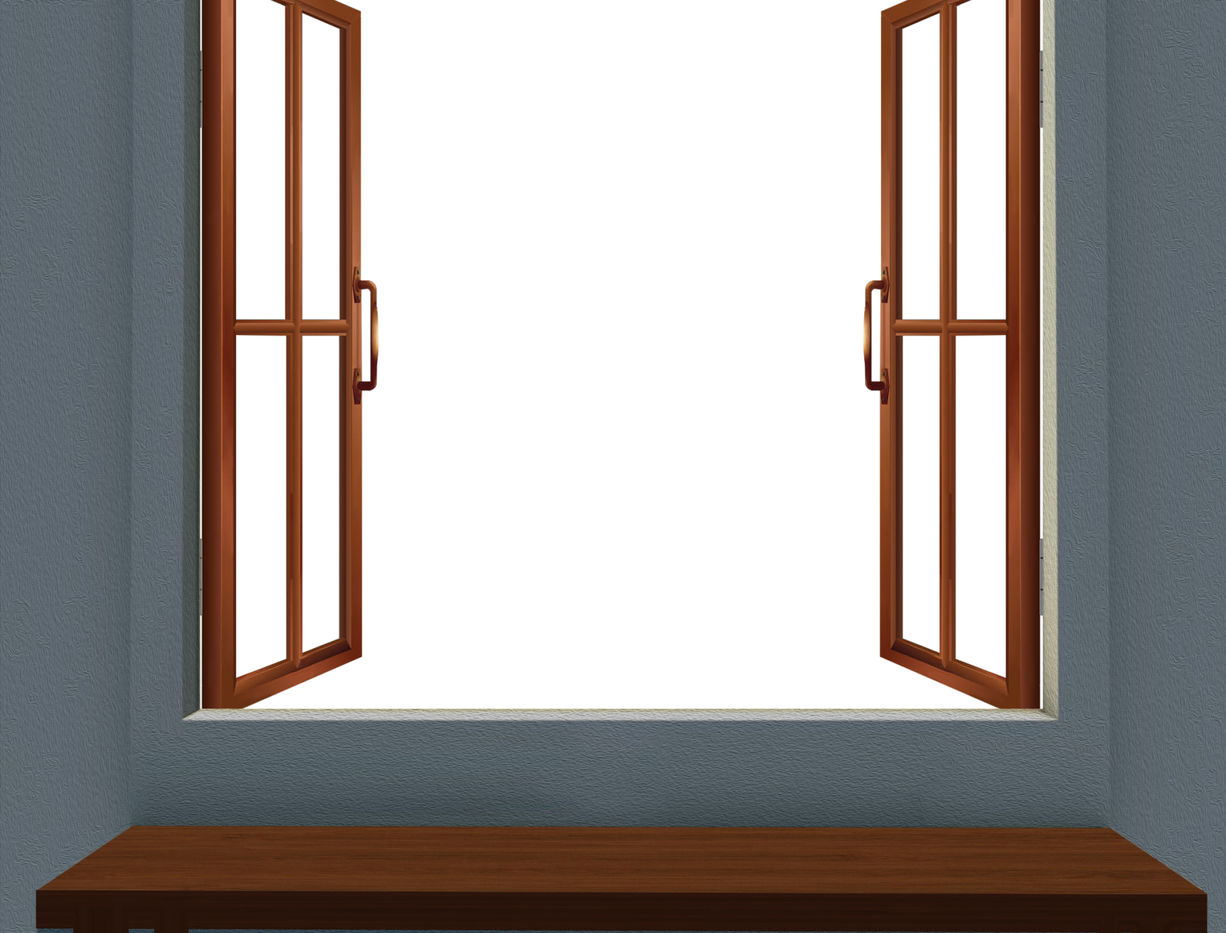
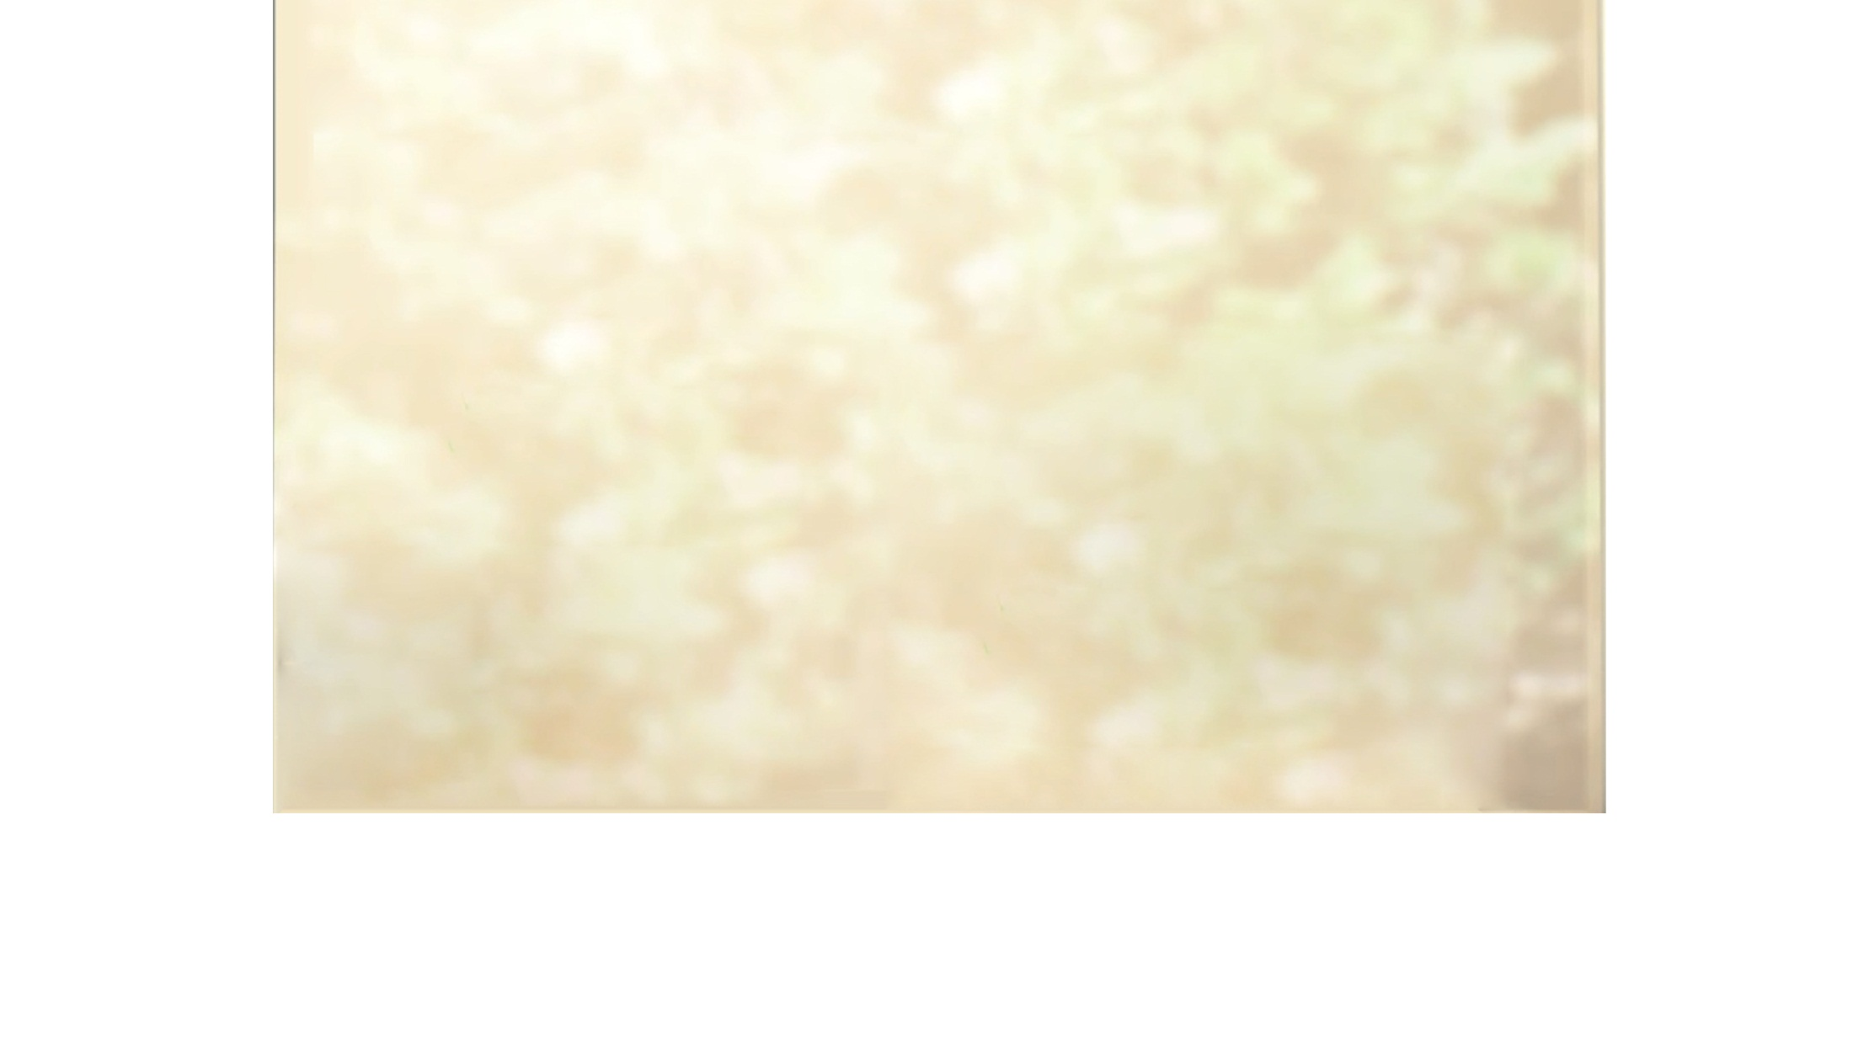


2
Sunlight
AgBr_{(s)}
2
Ag_{(s)}
+
Br_{2(g)}
DECOMPOSITION REACTIONS DUE TO LIGHT
Silver bromide
Silver
Bromine
2
AgCl_{(s)}
Sunlight
2
Cl_{2(g)}
Ag_{(s)}
+
Silver chloride
Silver
Chloride
Decomposition due to light is called Photolysis.
Silver bromide

Slide 57

Both these reactions are used in
black and white photography
during the process of developing.

Slide 58

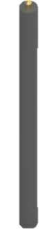
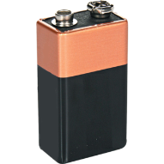
Electricity
Acidified water is the water mixed with few drops of acid
Decomposition due to Electricity is called Electrolysis.
Uses of electrolysis:
Extraction of metals like sodium, aluminium electroplating
2
H₂O_{(l)}
2
H_{2(g)}
+
O_{2(g)}
Water
Hydrogen
Oxygen
Acidified water is used to produce ions (ionisation)
Oxygen
Hydrogen
Test tube
Plastic mug
Graphite rod
Water
Rubber stopper
Anode
Cathode
Dilute sulphuric acid
Switch

Slide 59
CHEMICAL REACTIONS AND EQUATIONS
Module_08

Slide 60
REACTIVITY SERIES OF METALS
K
Potassium
Most reactive
Na
Sodium
Ca
Calcium
Mg
Magnesium
Al
Aluminium
Zn
Zinc
Fe
Iron
Pb
Lead
Reactivity decreases
[H]
Hydrogen
Cu
Copper
Hg
Mercury
Ag
Silver
The arrangement of metals in the increasing or decreasing order of reactivity is called the reactivity series of metals.
Au
Gold
Least reactive

Slide 61
DISPLACEMENT REACTION
AB
+
C
A
+
CB
When a more reactive element removes another (similar) element, having less reactivity, from its compound, these reactions are termed as DISPLACEMENT REACTIONS.

Slide 62
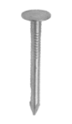
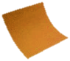
CuSO_{4(aq)}
+
Fe_{(s)}
FeSO_{4(aq)}
+
Cu_{(s)}
Copper sulphate
Iron
Iron sulphate
Copper
K
Potassium
R
E
AC
T
I
V
I
T
Y
D
E
C
R
E
A
S
E
S
Na
Sodium
Li
Lithium
Ca
Calcium
20 Mins
Mg
Magnesium
Al
Aluminium
Zn
Zinc
Fe
Iron
Sn
Tin
Pb
Lead
Cu
Copper
Copper sulphate
solution
Ferrous sulphate solution
Hg
Mercury
Ag
Silver
Au
Gold
Sand paper
Iron nail

Slide 63
K
Potassium
R
E
AC
T
I
V
I
T
Y
D
E
C
R
E
A
S
E
S
Na
Sodium
Li
Lithium
Ca
Calcium
Mg
Magnesium
Al
Aluminium
Zn
Zinc
Fe
Iron
Sn
Tin
CuSO_{4(aq)}
Cu_{(s)}
Pb
Lead
Zn_{(s)}
+
ZnSO_{4(aq)}
+
Zinc
Copper sulphate
Zinc sulphate
Copper
Cu
Copper
Hg
Mercury
Ag
Silver
Pb_{(s)}
+
CuCl_{2(aq)}
PbCl_{2(aq)}
+
Cu_{(s)}
Zinc displaces copper
Au
Gold
Lead
Copper chloride
Lead
chloride
Copper
Lead displaces copper

Slide 64
CHEMICAL REACTIONS AND EQUATIONS
Module_09

Slide 65
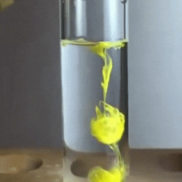
DOUBLE DISPLACEMENT REACTION
A⁺B⁻
+
C⁺D⁻
A⁺D⁻
+
C⁺B⁻
The reactions where a precipitate is formed by exchange of ions between the reactants, are examples of double displacement reactions.
During double displacement reaction an insoluble substance is form known as precipitate.
Any reaction that produces a precipitate can be called a precipitation reaction.

Slide 66
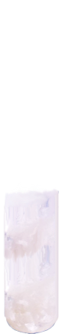
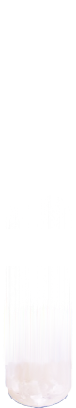
+
-
+
-
+
-
+
-
REACTION BETWEEN BARIUM CHLORIDE AND SODIUM SULPHATE
Na₂SO_{4(aq)}
+
BaCl_{2(aq)}
BaSO_{4(s)}
+
2
NaCl_{(aq)}
Sodium
sulphate
Barium
chloride
Barium
sulphate
Sodium
chloride
(white ppt)
Test tube containing solution of barium chloride
Test tube containing solution of sodium sulphate

Slide 67
Precipitate is symbolized by an
arrow pointing downwards
+
-
+
-
+
-
+
-
BaS
+
ZnSO₄
BaSO₄
+
ZnS
Barium sulphide
Zinc sulphate
Barium sulphate
Zinc sulphide
(white ppt)
+
-
+
-
+
-
+
-
CuCl₂ _{(aq)}
+
2
KI _{(aq)}
CuI_{2(s)}
+
2
KCl_{(aq)}
Copper chloride
Potassium iodide
Cupric iodide
Potassium
chloride
(brown ppt)

Slide 68
CHEMICAL REACTIONS AND EQUATIONS
Module_10

Slide 69

OXIDATION AND REDUCTION REACTION

Slide 70
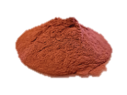
OXIDATION REACTION
Cu_{(s)}
+
O_{2(g)}
CuO_{(s)}
2
2
Copper
Oxygen
Copper oxide
Copper is gaining oxygen to form copper oxide.
Copper powder
Copper (II) oxide
China dish
Wire gauze
Tripod stand
Bunsen burner

Slide 71
Ethyl alcohol has lost hydrogen
Hence, oxidation is the gain of
oxygen or loss of hydrogen.
C₂H₅OH_{(l)}
C₂H₅ONa
H
2
H
+
Na
+
H₂
2
2
Ethyl alcohol
Sodium
Sodium ethoxide
Hydrogen gas

Slide 72
REDUCTION REACTION
Reduction is the loss of oxygen or
gain of hydrogen.
C
+
H₂
CH₄
2
Hydrogen gain
Carbon
Hydrogen
Methane
O₃
O₂
+
[O]
Ozone
Oxygen
Nascent oxygen
Oxygen lost

Slide 73
CHEMICAL REACTIONS AND EQUATIONS
Module_11

Slide 74
REDOX REACTION

Slide 75
REDOX REACTION
When oxidation and reduction take place simultaneously in a given
chemical reaction, it is known as REDOX REACTION.

Slide 76
CuO is changing to Cu
H₂ is changing to H₂O
Oxygen is being removed from CuO
Oxygen is being added to hydrogen
Copper oxide is being reduced to copper
Hydrogen is being oxidised to water
CuO gives oxygen for Oxidation
H₂ REMOVES oxygen
(O₂ lost)
Reduction
OXIDISING AGENT
REDUCING AGENT
+
H₂
Cu
CuO
+
H₂O
(The substance which gives
oxygen for oxidation is
called an oxidising agent)
(The substance which
removes oxygen is called as
reducing agent)
(O₂ added)
Oxidation

Slide 77
(O₂ lost)
Reduction
OXIDISING AGENT
REDUCING AGENT
BaSO₄
C
BaS
4
BaSO₄
+
C
+
CO
4
(O₂ added)
Oxidation

Slide 78
(O₂ lost)
Reduction
OXIDISING AGENT
REDUCING AGENT
+
C
Zn
+
CO
ZnO
C
ZnO
(O₂ added)
Oxidation

Slide 79
(O₂ lost)
Reduction
OXIDISING AGENT
REDUCING AGENT
+
HCl
MnCl₂
MnO₂
HCl
+
H₂O
+
Cl₂
MnO₂
4
2
(O₂ added)
Oxidation

Slide 80
CHEMICAL REACTIONS AND EQUATIONS
Module_12

Slide 81
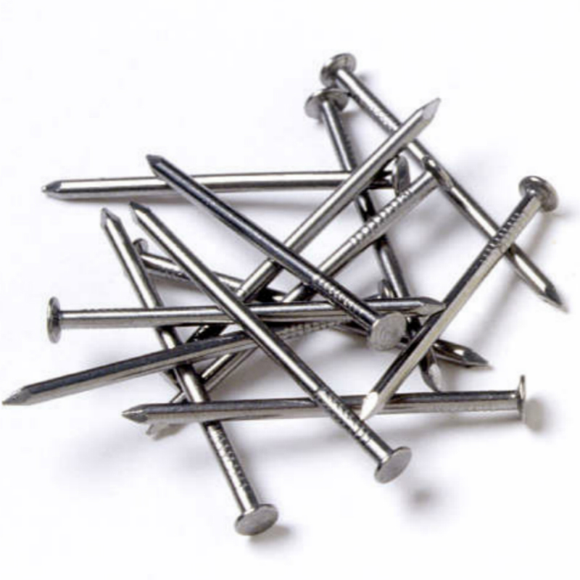
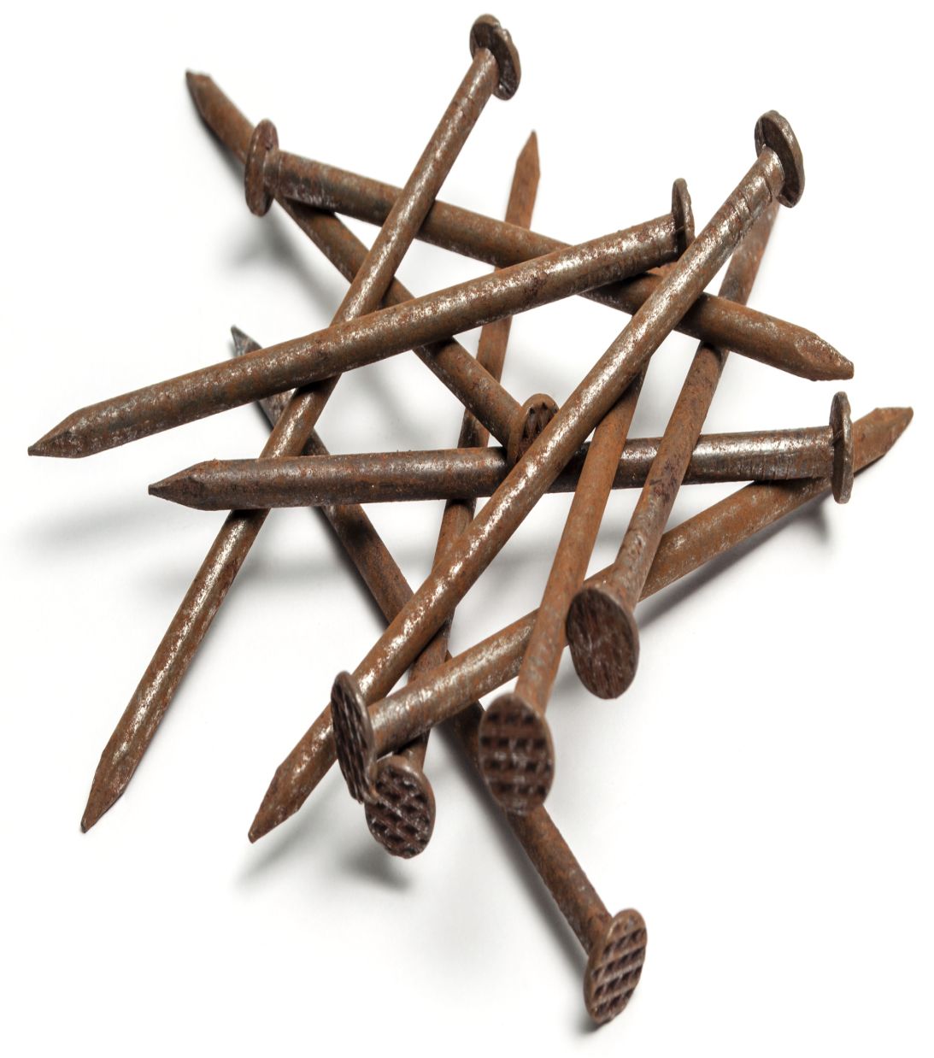
CORROSION
The slow process of decay
or destruction of metal due
to the effect of air,
moisture, acids on it is
known as CORROSION.
Due to effect of moisture a
layer of reddish brown colour
is deposited over surface of
iron, called rust. Its chemical
formula is Fe₂O₃.H₂O.

Slide 82
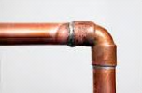
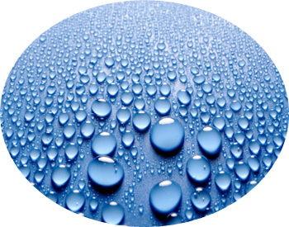
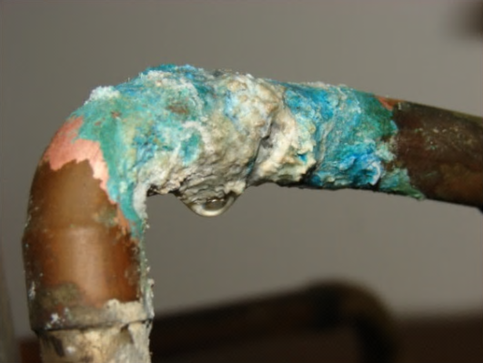
Copper objects get coated with a green substance called copper carbonate with the passage of time.
This green substance is formed the due to the reaction of copper with carbon dioxide and moisture present in the atmosphere.
Copper
Moisture and
Carbon dioxide

Slide 83
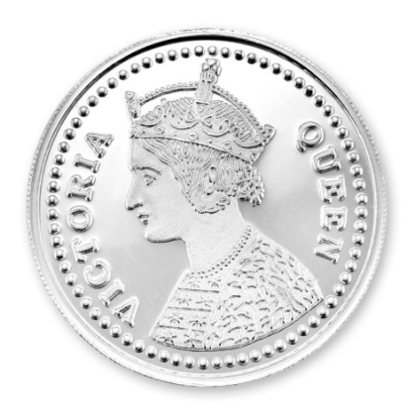


Silver objects become blackened and lose their shining with the passage of time.
This happens due to the reaction of silver with hydrogen sulphide gas present in the atmosphere.
Silver

Slide 84

RANCIDITY
When oil and fats are oxidized or even allowed to stand for a long time, they become RANCID.
Food smells foul and its taste changes.

Slide 85


TO PREVENT RANCIDITY
Food is placed in air tight container
Chips are stored in nitrogen as nitrogen is least reactive
Antioxidants are used to prevention oxidation of food containing fats and oils.
Food are also stored in refrigerator as low temperature reduces the rate of reaction
It is also advised to store food away from sunlight, as sunlight can increase the rate of reaction

Slide 86
Thank You

